Slide 1

Club Member Churn
ANALYSIS & SOLUTIONS
Presented by Duong Minh Truc

Slide 2




AGENDA
01
02
03
04
Problem Statement
Overview
Model
Description
Solutions
Recommendations for churn reduction
Churn rate
Club’s member
Random Forest
Club’s requirement
Feature ranking

Slide 3

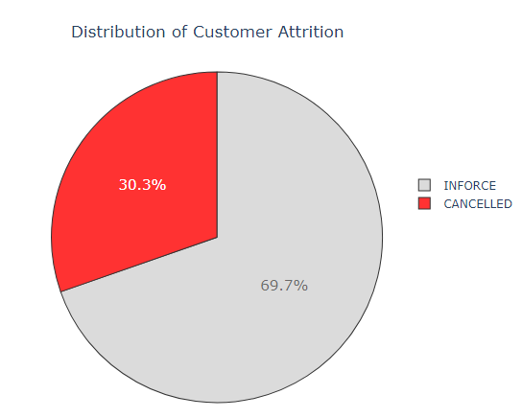

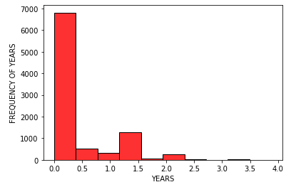


PROBLEM STATEMENT
Customer retention is the major challenge the premium club is facing.
Distribution of customer attrition
Churn rate accounted for 30.3% of total customers. Among the cancelled members, the longest-serving ones stayed for at most 3.5 years and 75% of them were members for almost half a year.
CLUB’S PLAN
IDENTIFY CUSTOMER AT RISK
Insufficient bandwidth to reach out to the entire customer base individually
Statistical approach

Slide 4
STATISTICAL APPROACH
Machine learning – based classification method is used for churn prediction.
Define Target
Retrieve
Data
Engineer
Feature
Build Model
EDA
Evaluate
What are the key drivers for membership cancellation? How did they cause customers to quit the club?
Sample on relevant historical data provided by the premium club
(16 columns, 9325 entries).
Extract initial insights on characteristics of club members in general and those who canceled membership in particular.
Select and transform the most relevant variables from raw data to feed into the machine learning model.
Build certain base models to compare and pick one with highest predictive performance to optimize by hyper-parameter tuning.
Generate list of important features after evaluating with a variety of metrics and propose solutions to solve the problem.
4

Slide 5















OVERVIEW – DATA SET
Each member is identified by a number along with numerous features.
Package: Type A, Type B
Male, Female, Unknown
Addition: 0 – 3 members
Married, Single, Divorced,
Widow, Unknown
Demographics
Range: 99.999 – 10.100.000
Start date
Inforce
Range: 0 – 92 years old
Club
Membership number
Occupation code: 0 - 6
Membership status
Cancelled
Terms: 0 – 102 years
Range: 0 – 999.999.996
Agent: 4025 unique code
End date
Payment mode: Annual, Semi-annual,
Quarterly, Monthly, Single-premium
Features
5

Slide 6
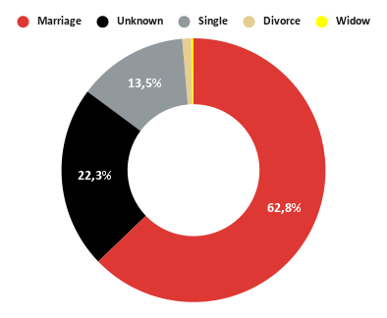
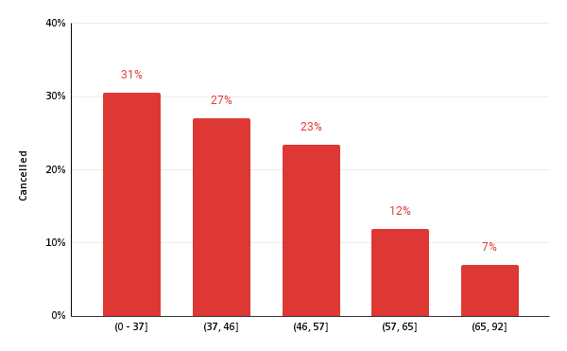
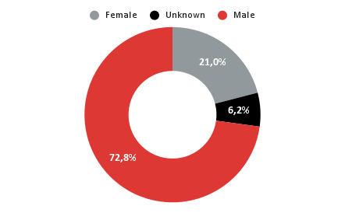
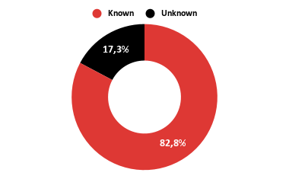
EXPLORATORY DATA ANALYSIS
Marital status
General insights into customer demographics
Age group
Among the group of canceled members, 6.2% of customers who decided to
not share their gender ...
Gender
.... also reveal neither their marital status nor annual income.
58% of club leavers were aged 46 or younger. These people’s jobs belonged to group 1, 4, and 5.
Occupation code
(with the highest churn rate)
0 1 2 3 4 5 6
Annual income
6

Slide 7
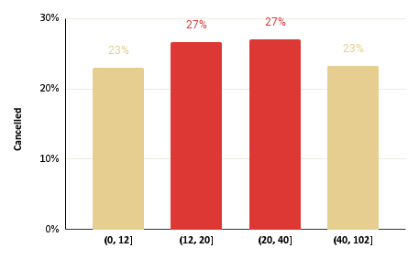
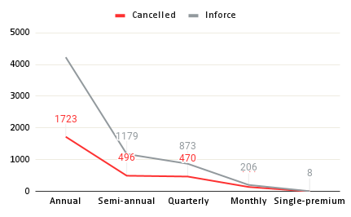
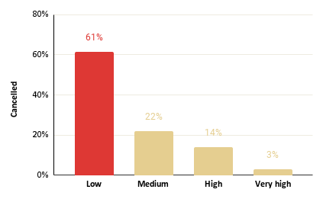
EXPLORATORY DATA ANALYSIS
Term years
General insights into premium buying patterns
Payment mode
Only 8 people bought single-premium and all of them still enforced their membership
Any rows relevant to these 8 people will be removed because of no contribution in predicting churn
Annual fees
People enrolling in LOW-FEE annual contract were the most likely to leave the club at will.
Additional members
Package type
(show the highest churn rate)
(show the highest churn rate)
0 1 2 3
2293
B
A
7

Slide 8


STATISTICAL SIGNIFICANCE
Based on Weight of Evidence (WOE) and Information Value (IV), no strong predictive feature was found. Some were at the medium level while the majority were weak.
Methodology: create bins of observations.
Categorical variables: each category is a bin, but some smaller categories can be grouped together
Continuous variables: split into categories
Suppose variable X is good in distinguishing between a binary response (e.g. “good” versus “bad”) in some target variable Y.
WOE = ln(%good) – ln(%bad)
IV = ∑ (%good - %bad)*WOE
Medium
Age
Term years
Package type
0.1 – 0.3
Annual fees
Annual income
Additional members
Payment mode
Term years
Occupation code
Weak
0.02 – 0.1
The need for ...
... create new feature
0.44
0.036
Gender
Marital
status
Unpredictive
Strong
predictive power
Count
Canceled Agent
Correlation
with target
< 0.02
8

Slide 9
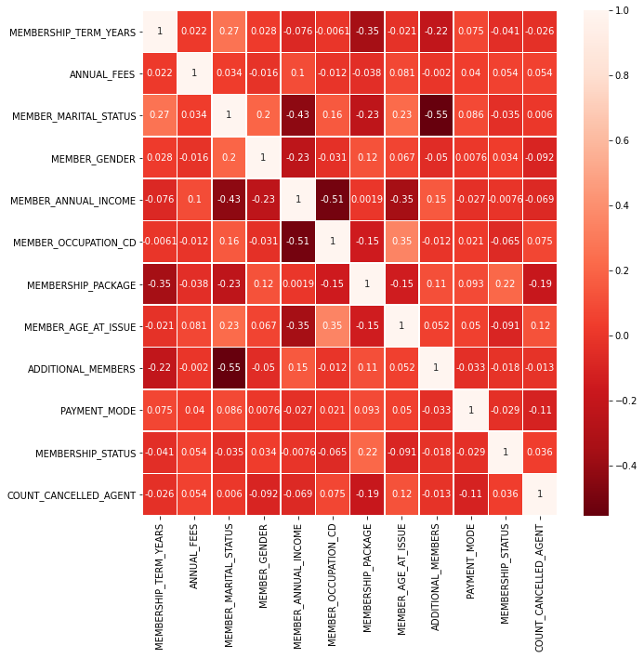
FEATURE ENGINEERING
Fill missing values
Correlation between target and transformed independent features
Data type | Value to fill
Numerical variable | 0
Categorical variable | UNKNOWN
Data transformation
Feature | Transformation
Membership status | INFORCE | 0
 | CANCELLED | 1
Package | TYPE - A | 0
 | TYPE - B | 1
Payment mode | ANNUAL | 1
 | SEMI-ANNUAL | 1/2
 | QUARTERLY | 1/4
 | MONTHLY | 1/12
Gender Marital status | Label Encoding
Annual fees Annual income | Log Transformation
9

Slide 10
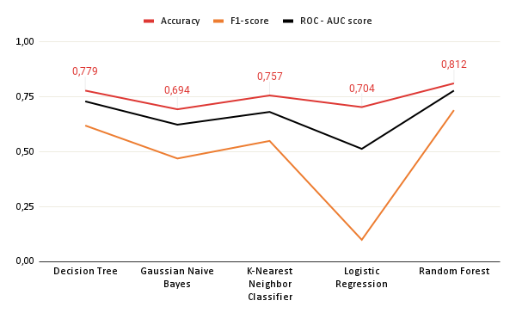

MODELING APPROACH
Create certain base models as benchmark and optimize the one with the highest outcome
Evaluation result by Base Model
Base models are models with default parameters so their results can be used as a threshold to optimize.
Logistic Regression is underperform compared to the other 4 techniques. This maybe due to multiple decision boundaries in need for classification.
Random Forest is a strong learner due to the embedded feature selection in the model generation process. It is also great when dealing with unbalanced data.
10

Slide 11
OPTIMIZATION
This phase consists of two works: hyperparameter tuning and K-fold cross-validation
Parameter Grid
Final Parameters
Parameters | Range of value
Min samples leaf | 1, 2, 3
Min samples split | 1, 2, 3, 5, 7
Numbers of estimators | 100, 150, 200, 250
Parameters | Range of value
Min samples leaf | 2
verbose | 1
Numbers of estimators | 150
njobs | -1
GridSearchCV (cv=3, njobs=-1, verbose=2)
The whole data set is split into train and test set with the ratio of 0.75:0.25
10
0.815
Final model:
Random Forest
FOLDS
K-FOLD
CROSS-VALIDATION
MEAN
ACCURACY
11

Slide 12
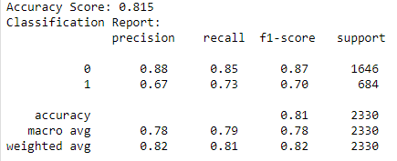
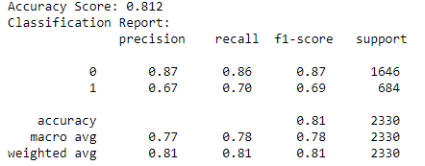
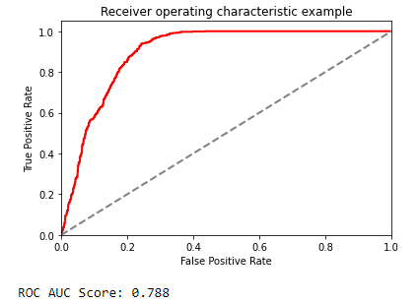
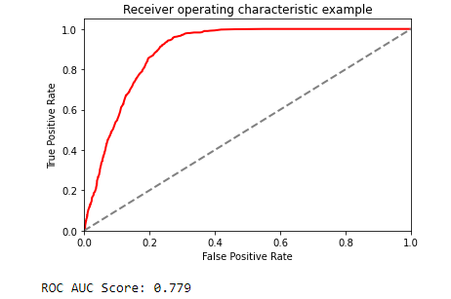
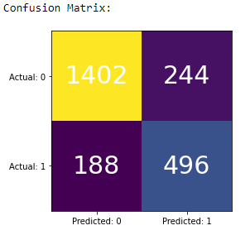
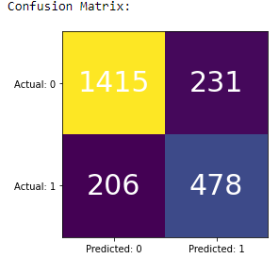
OPTIMIZATION
Random Forest model produced higher outcome across all metrics
After tuning hyperparameter
Before tuning hyperparameter
12

Slide 13
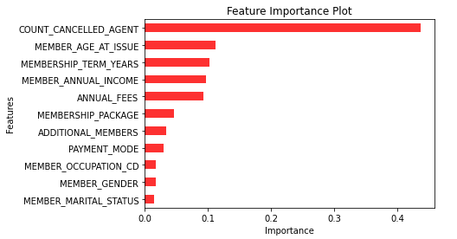
FEATURE RANKING - RECOMMENDATION
After optimization, the tuned model generated a list of top important features
COUNT CANCELLED AGENT
Reassess services provided by group of agents with the most canceled members.
MEMBER’S AGE AT ISSUE
Implement satisfaction survey for group of customers with age of 46 or younger to understand their pain points.
MEMBERSHIP TERM YEARS
Segment customers into groups based on their term years to identify who is worth pursuing to recommend the suitable payment mode and premium fees.
MEMBER’S ANNUAL INCOME
Check again the package price offer suitable for each type of customers (affluent, rich, middle-class and poor)
ANNUAL FEES
Provide key functional benefits of product and regular news updates, such as announcements of deals, special offers or upcoming upgrades for annual package to retain customers
13

Slide 14


Thank you
Q&A

